Slide 1
Chapter 2 Introduction
Software Analysis and Design
0721322

Slide 2
Requirements Analysis
The purpose of requirements analysis is to produce an analysis or a logical model of the desired system.
The analysis model can be seen as a bridge between the requirements model and the design model.

Slide 3
Requirements Analysis vs Design
During Requirements a Use-Case Model is developed to capture the requirements of the system.
Requirements analysis focuses on understanding the requirements of the desired system to produce a high-level specification that describes what the system should do.
During Design, we should specify clearly how the system should be constructed to satisfy the requirements.

Slide 4
Transition from Requirements to Design
Use-case Realization
From Use-cases to Analysis model
Analysis model includes a “Conceptual” Class diagram, in addition to other UML diagrams.

Slide 5
Transition from Requirements to Design
Object-oriented analysis and design using UML, 4th edition
Simon Bennett, Steve McRobb and Ray Farmer

Slide 6
Design
We cannot move directly from requirements (high level) to implementation (low level)
The purpose of design phase is to produce a detailed specification of the desired system that satisfies the requirements.
Programmers translate the design document into a programming language to build the desired system.

Slide 7
Design
Architectural Design (called system design)
Interface Design
Database Design
Algorithm Design
Application Design
Refining the Analysis model

Slide 8
Design Levels
Architectural Design (sometimes called System Design)
High-Level Design
Low-Level Design (sometimes called Detailed Design)

Slide 9
Software Design Principles
Correctness
Software design must satisfy the requirements.
Many correct designs may exist
How to know that a design is correct?
Formal approaches
Informal approaches

Slide 10
Software Design Principles
Correctness
Informal approaches require that the design must be:
Readable (to enhance understanding)
Modular (to deal with complexity)

Slide 11
Software Design Principles
Robustness
The degree to which a system or component can function correctly in the presence of invalid inputs or stressful environmental conditions (IEEE).
Invalid inputs could come from users, data communication or function calls.
Some errors might be caused by development team ( for example in design, implementation, etc.)

Slide 12
Software Design Principles
Robustness
How to ensure robustness?
Verifying inputs ( type checking, preconditions )
Initializing variables or objects instead of relying on default values in programming languages.
Exceptions handling.

Slide 13
Software Design Principles
Flexibility
Adding more functionalities ( adding a function, a class , etc.)
Changing functionalities

Slide 14
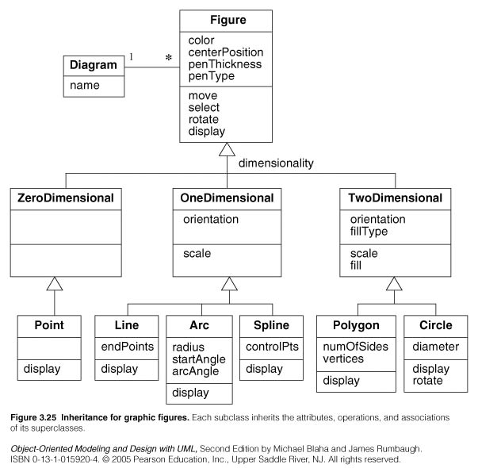
Software Design Principles
Flexibility

Slide 15
Software Design Principles
Reusability
Could be done on different levels:
Functions, classes, components, design patterns, frameworks, etc.

Slide 16
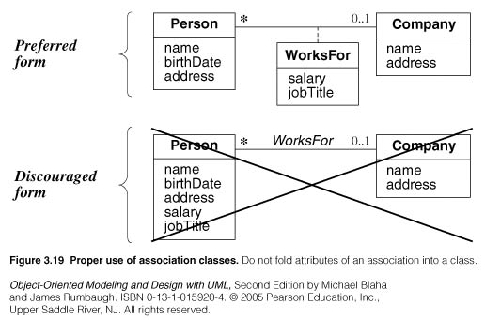
Software Design Principles
Reusability

Slide 17
Software Design Principles
Efficiency
In time (algorithms complexity)
In space

